Slide 1
DES520-Communication Design for Business
End-of-Course Assessment - January Semester 2023
Sruthi Madhusudanan
Submission date :26 April 2023

Slide 2
This ECA document is set in Source Sans Pro Typeface and design of content is set in Source Serif Pro ,prepared by Sruthi Madhusudanan for the submission of DES520-Communication Design for Business

Slide 3
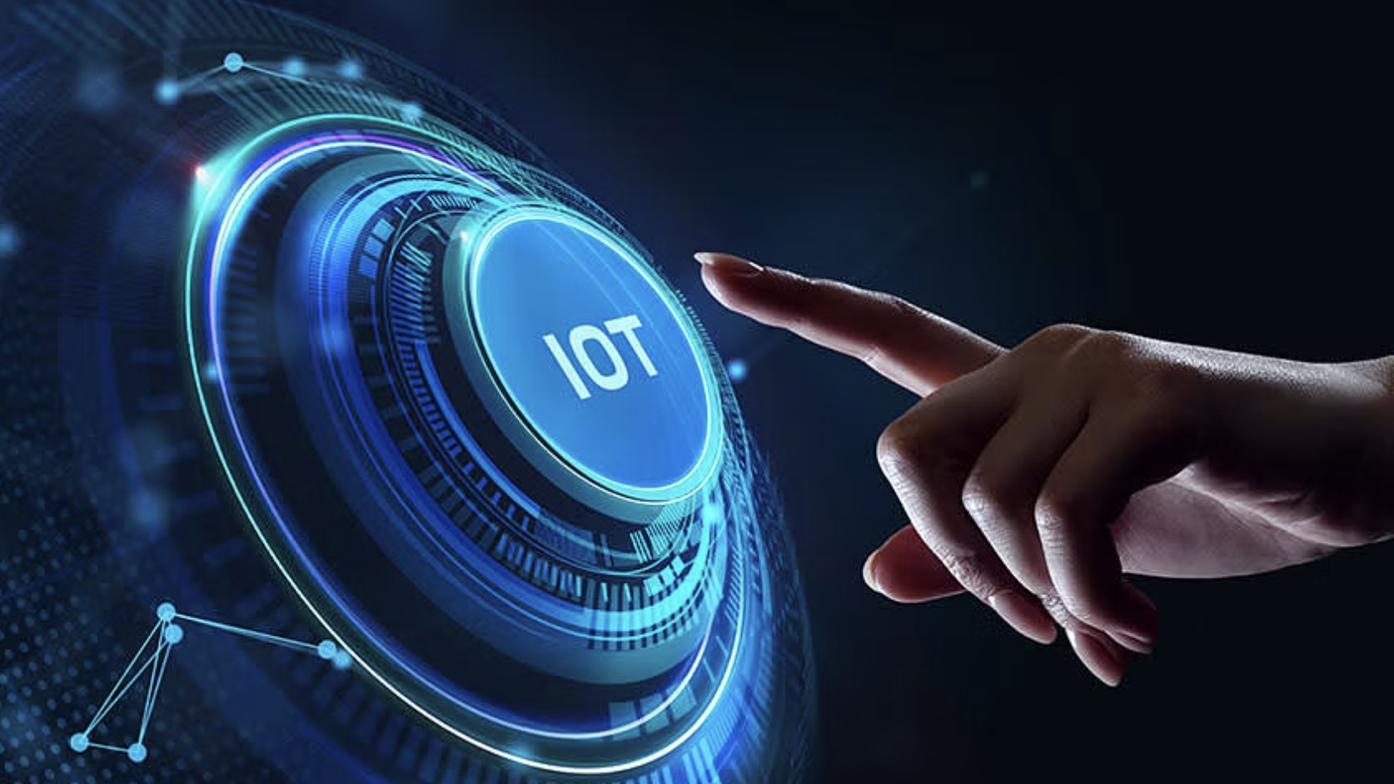
Table of content
Question 2
Thinking and Making Process
Page no : 14- 19
Question 1
Final design
Page no : 4 -13
Question 3 Reflection
Page no : 20-23
References
Page no : 24-25

Slide 4
Question 1
Final Design
Source serif pro

Slide 5
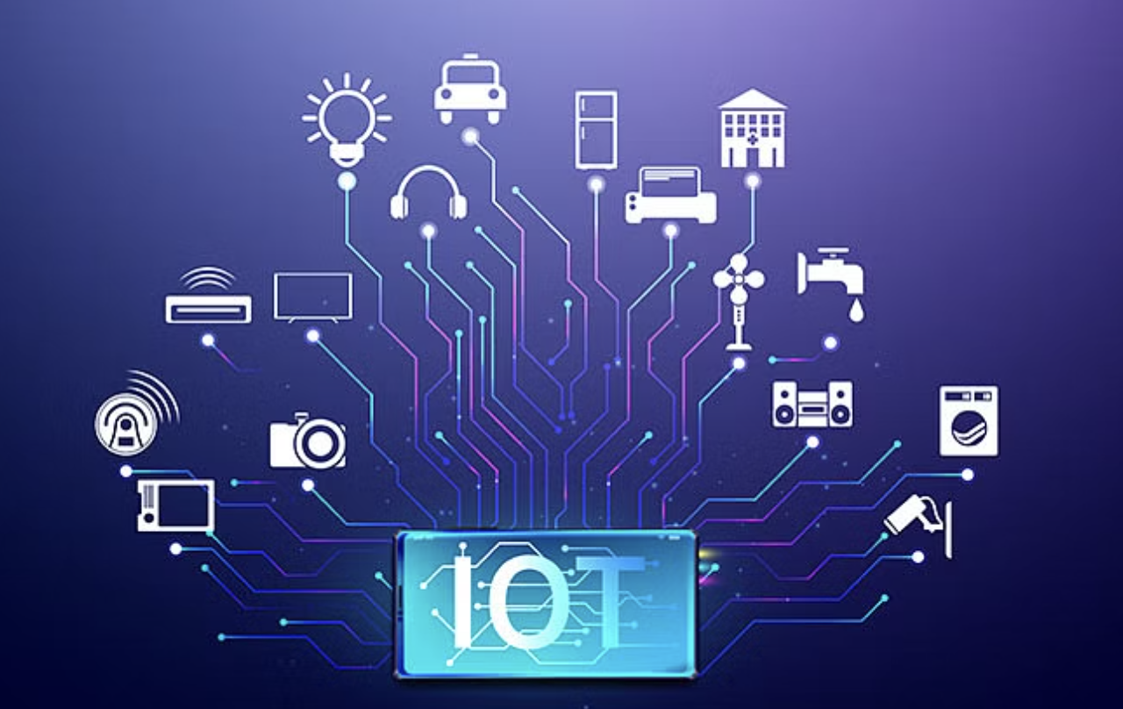
There’s a lot of noise now about the Internet of Things (IoT) and its impact on everything!
But what is the Internet of Things ?
"Simply, the Internet of Things is made up of devices – from simple sensors to smartphones and wearables -connected,”
-Matthew Evans, the IoT program head at techUK
The Internet of Things (IoT)
IoT has revolutionized how we interact with our environment
A powerful interconnected web that brings us into the age of automation, enabling physical objects and devices to talk and act.
IoT encompasses everything connected to the internet, but it is often used to define objects that "talk" to each other.
From controlling home appliances remotely with our phone to mon- itoring vehicle perform- ance miles away.
Provides real-time data increa sing efficiency, convenience, & enables new & innovative applications & services.
Can be leveraged in the business world to drive innovation improve operations and increase profitability.
.

Slide 6
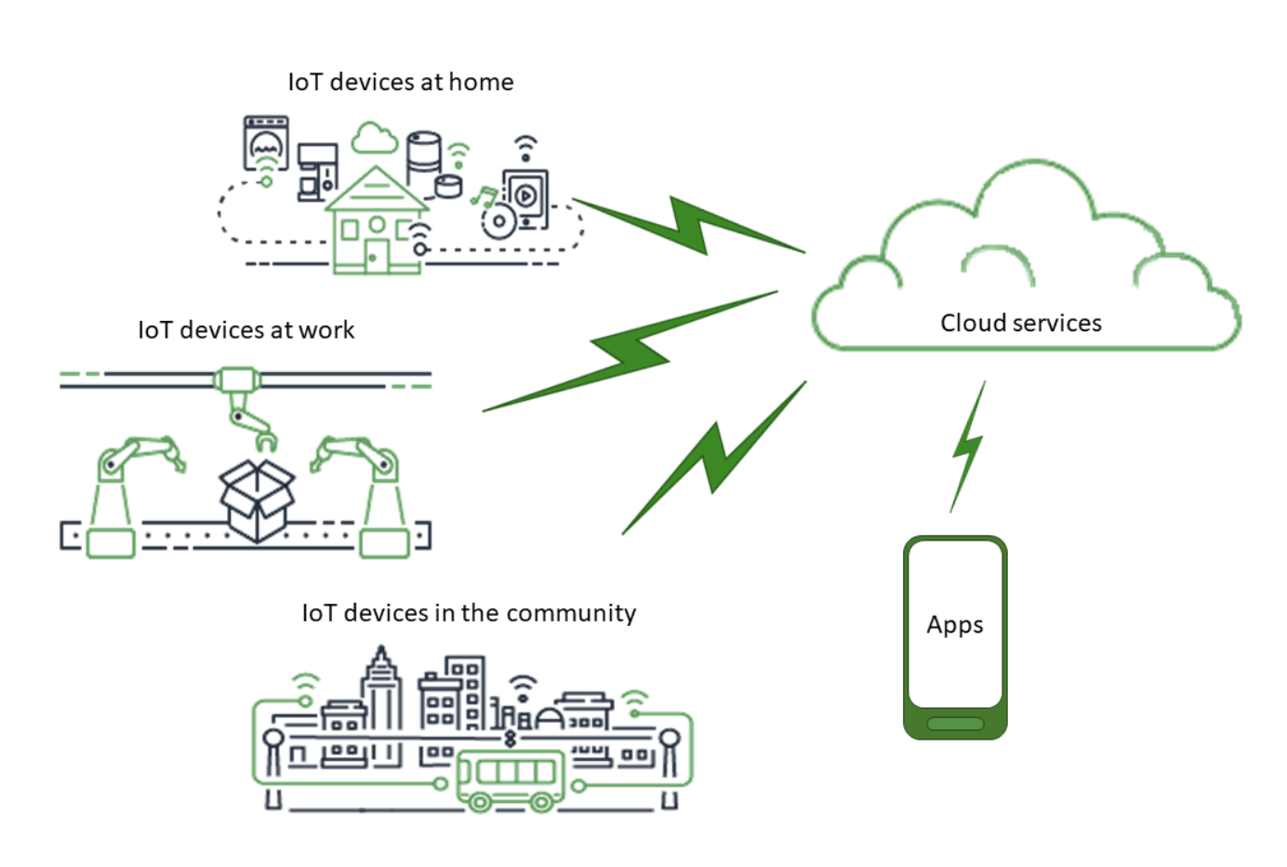
Working
Devices and objects with built-in sensors are connected to an IoT platform, which integrates data from the different devices and applies analytics to share the most val- uable information with applications bu- ilt to address specific needs
IoT Platforms could
Pinpoint information that are useful and which are safe to ignore .
This information used to detect patterns, make recomme- dations, and detect possible problems before they occur.
For example,
A car manufacturing business- To know which optional components (leather seats or alloy wheels, for example) are the most popular.
Using IoT technology
Use sensors to detect which areas in a showroom are the most popular, and where customers linger longest;
Drill down into the available sales data to identify which components are selling fastest;
Automatically align sales data with supply, so that popular items don’t go out of stock. The information picked up by connected devices enables to make smart decisions about the components to be stock up on, based on real-time information, which saves time and money

Slide 7
Requirements for IoT to work
A typical IoT system works through the real-time collection and exchange of data.
Components
Smart devices
Collects data from its environment, user inputs, or usage patterns
Communicates data over the internet to and from its IoT application
IoT application
Collection of services and software that integrates data received from various IoT devices
Decisions made using ML or AI are communicated back to the IoT device which then responds intelligently to inputs.
A graphical user interface
Manages IoT device or fleet of devices
Examples- website that can be used to register and control smart devices
Examples-Television, security camera, or exercise equipment, with given computing capabilities

Slide 8
Uses
Potential uses are unlimited
Smart products could perform
Maintenance reporting,
Diagnostics on themselves,
Identify faults,
Communicate them to technical support,
Initiate actions to resolve – from ordering replacement parts to requesting a completely new device.
Impact
The new rule for the future is going to be,
"Anything that can be connected, will be connected”
What this might look like or what the potential value might be?
If traffic is heavy car sending text to other party notifying you will be late
Car knows best route based on your meeting schedule in your calendar.
Alarm clock wakes you at 6 am and notifies coffee maker to start.
Office equipment auto-reorders when supplies are low.
Wearable device tracking productivity and sharing data with other devices.

Slide 9
Internet of Things mean for your business
Before IoT
Customer relationships - face-to-face and telephone contact
long and indirect chain of communication between producer and retail staff, sales reps, repairs, complaints departments as the link between the two .
IoT
Customer Relationship Management -Real-time data about Customers
Understand customers in a whole new way, and with a level of detail that until now has simply not been possible.
IoT Devices
Smart Home Devices
Enhanced convenience, security, and control over the home environment
Smart thermostats
Smart lights
Set schedules and control the lights at home for when they should turn on or off
Smart smoke detectors
Sends alerts to smartphone if they detect smoke or carbon monoxide
Smart home assistants
Devices like Amazon Alexa controls different aspects of your home and perform tasks such as setting reminders or playing music
Smart locks
Smart security cameras
Use smartphone or tablet to monitor and control home temperature
Controls and monitors locks remotely, making it easy to lock or unlock your door from smartphone
Monitors remotely and receive notifications when there is activity

Slide 10
IoT Devices
Wearables
Fitness trackers
Devices like Fitbit track physical activity and help you monitor an array of data from heart rate to calories burned as well as sleep patterns.
Smartwatch
VR/AR headsets
Devices like the Apple Watch can be used to send and receive texts and calls, track physical activity, and monitor health
Smart glasses
Devices like the Microsoft HoloLens allow users to experience VR and AR environments.
L’Oréal is using this to improve customer experience.
Devices like Google Glass provide augmented reality displays and hands-free computing.
Smart Healthcare Devices
Fitness trackers and smartwatches to track vital signs, physical activity, and sleep patterns, providing data for healthcare professionals.
Remote patient monitoring devices
Smart pill dispensers
Allows patients to monitor their health conditions from home and send data to their healthcare providers
Smart inhalers
Reminds patients to take their medications and track whether they have been taken.
Tracks the usage of inhalers and send data to healthcare providers for monitoring and analysis.
Wearable health monitors

Slide 11
IoT Devices
Smart City Devices
Smart cities use IoT to improve the quality of life for their citizens and make cities more sustainable and efficient.
IoT-enabled streetlights can be controlled and monitored remotely, reducing energy usage, and improving public safety.
Traffic management
Environmental monitoring
IoT sensors can be used to monitor traffic flow, optimize signal timings, and reduce congestion
Smart waste management
IoT devices can be used to monitor air quality, water quality, and waste levels, improving sustainability and public health.
IoT sensors and devices can be used to optimize the collection and disposal of waste, reducing waste and improving sustainability.
Smart lighting

Slide 12
How To Get Started with IoT for Your Business
Steps
1. Identify business needs
Start by asking yourself what issues your business needs to solve and what opportunities you want to grab .Identifying those areas where it can best apply its problem-solving super- powers will help ensure that each step taken with this cutting-edge technology is strategic in nature.
2. Assess your technology infrastructure
Make sure that your technology infrastructure is up to date and can support IoT devices. You will need a robust network and reliable internet connectivity to make the most of IoT
3. Research IoT solutions
Research the various IoT solutions available and identify the ones best suited to your business needs. Make sure to consider factors such as cost, compatibility with your existing technology, and ease of use. Build a proof of concept: Once you have identified the right IoT solutions for your business, start with a small pilot project to test and validate the solution. This will help you understand the value IoT can bring to your business and identify any challe- nges or barriers you may encounter.
4. Start small and scale up
Start with a few IoT devices or solutions and gradually scale up as you become more comf- ortable with the technology. This will help you minimize risk and ensure that you use IoT in the most effective way possible.

Slide 13
How To Get Started with IoT for Your Business
Steps
5. Partner with an expert Consider partnering with an IoT expert, service provider, or experienced tech consultant to help you get started. They can provide guidance, support, and expertise to ensure that you are using IoT in the most effective way possible.
6. Consider security
Security should be a top priority when implem- enting IoT. Ensure to implement security measures such as encryption, firewalls, and secure authentication to protect your data and devices.
Analyze data and measure results
Glean insights from your IoT data to super-
charge the performance of your solution. Identifying areas where you can optimize will help ensure that it delivers maximum value for your business
By following these steps, you can get started with IoT in a structured and effective way and realize the benefits of this technology for your business.
Conclusion
Conversation about the IoT are taking place worldwide for years as we seek to understand how this will impact our lives. As more and more devices start to join IoT, we need to understand the opportunities and challenges that come with it. To prepare ourselves, we must educate ourselves about the IoT and the potential impacts that can be seen on how we work and live

Slide 14
Question 2
Thinking and Making Process
Source Sans pro

Slide 15
Purpose: The purpose of this artefact is to give a compre- hensive understanding of the Internet of Things(IoT) by introducing them to found- ational concepts. And create an aesthetically appealing booklet by utilizing design principles, which would aid in conveying information effectively to the audience.
Target audience: Here I have assumed that my audience has limited knowledge about IoT , so it is crucial to ensure that they understand the concept effectively and apply in day-to-day life.
Tone of voice: I hope to adopt a friendly and conversational way in my writing style and visuals , In order to help my audience, understand the fundamental ideas of IoT and its real-world applications in daily life. I want to make sure they grasp the value of the Internet of Things and how it affects our daily lives by utilizing simple explanations and real-life instances.
Orientation: For my booklet, I decided on a portrait page orientation because it seemed
to be the most effective manner for me to properly communicate message and apply design principles.
Size/ dimension: For this artefact I have chosen A4 portrait.
Format: The format of the presentation is digital , if required could also produce in a printed format.
Layout and composition: The layout is set as shown in the figure below.
Copy/ content structure: To enhance the clarity of the content , initially I copied everything and divided it into smaller sections with headings such as “working, uses, impact”. Also, I included infographics to present the information in a structured manner that is easily comprehensible to the audience.
Typography: I have chosen Source serif Pro for the design of content( i.e., Q1) and Source Sans Pro for the Q2 , Q3. My choice of using Source Serif Pro is based on its widespread usage in

Slide 16

books, magazines and newsp- apers which gives a formal, sophisticated, established and reliable look . I find these type- faces beneficial as they are big font family , which enables me to utilise multiple fonts for designing whole document thus enabling me to project the content in a best way .
I have used font size from 14-32 for our document.
I have utilized Black Italic, Italic , Bold font styles from Source Sans Pro type face for ECA document . And in Source Serif Pro I have used Semi bold italic , Bold, Italic, Regular for design document .
Imagery: To precisely communicate the concept of IoT, I have used several images that illustrate its various aspects. This approach of integrating visuals with the text allows for a clearer understanding of the content. Furthermore, the use of infographics has enabled me to present the content in a concise and visually appealing manner, thereby avoiding cluttered text and enhancing the readability of the document. References of the images at the end of document
Layout and composition: I have used A4 portrait layout with the grey shaded area as the margin for my whole document and the white area is where I have organised all the content . Whereas the background is set to light violet with is 47% transparency.

Slide 17
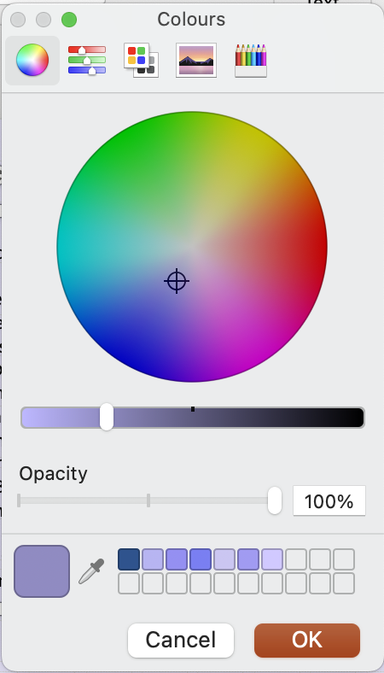
Color: I have primarily utilized various shades of Violet ,Grey and White to generate contrast between different content . For the background, I have employed shades of violet as it complements the black colored and white colored fonts and grey shaded infographics .This helped me to enhance the readability of the document. By leveraging light violet as, the
backdrop, I could bring the desired look that aligns with my design document ideas. I have tried creating new colors by clicking ” more fill colors “ and created shades of violet .
And have used these shades of violet as my primary color among white and grey .

Slide 18
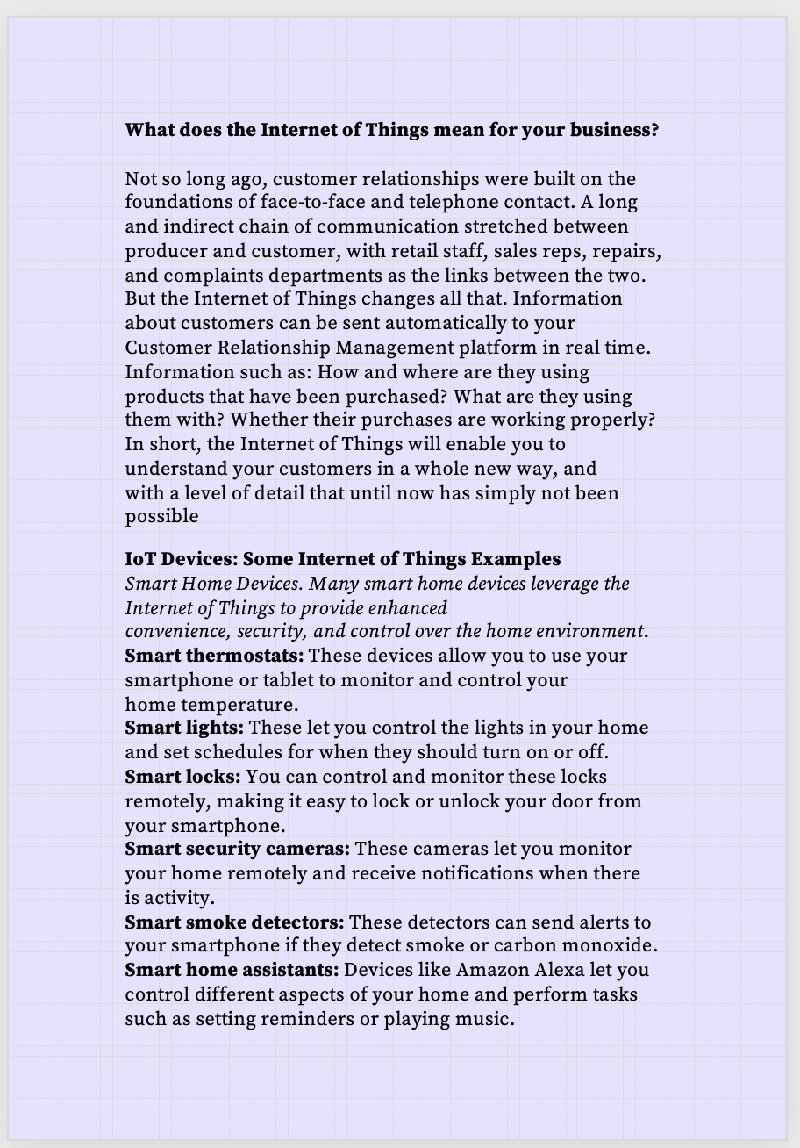
Removal of reductant information
Version 1
After viewing the content , I experiment- ed with the content by retaining critical infor- mation & restructuring it into table , with heading as Internet of Things mean for your business and under subheading before IoT and IoT
I have restructured this into infographics for better understanding and readability of the audience. Similar info- graphics have been in- corporated to all the IoT devices for making it stand out and visually appealing.
Final version of the above layout is given below

Slide 19
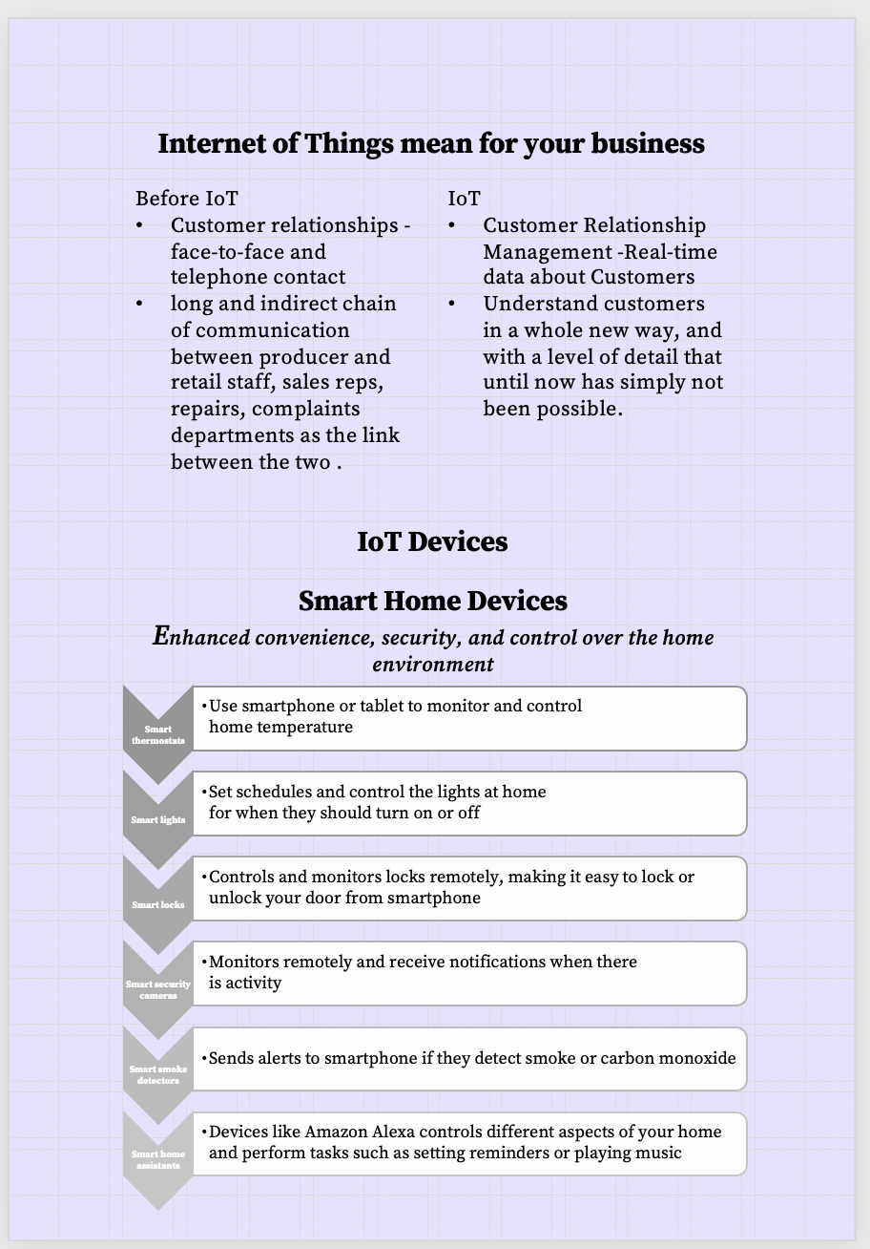
Removal of reductant information
Final version
This is the final version of the above layout , where critical information are retained to enhance readability. Having found the effectiveness of the infographics , I have applied it to all IoT devices

Slide 20
Question 3
Reflection
Source Sans pro

Slide 21
Learning point 1
Value of iteration (multiple versions) to arrive at final design
“what I meant by iteration is that the process of producing the final design after creating multiple versions through critical thinking , applying various design concepts for effective communication.”
Through this document design one particular learning point which inspired and which paved the way for my personal development is “ the process of design iteration” which helped me to understand the interaction between various design elements that affects the quality of the document .
Feelings and Reactions
Initially during the lectures I thought it would be easy and the same not so effective to try various elements and arrive at final version after numerous versions, but once I did the assignments , I found out that these process is really useful ,challenging as it involves critical thinking and applying various design principles in the right way .
Evaluation and Analysis
This learning point helped me to develop a deeper understanding of the co-relation between various design elements. By experimenting with different combinations of design elements like typography, color, visuals, and imagery, I understood how each element affects the overall look and feel of the design. This process of creating multiple versions of the design also helped to identify potential design issues and errors early in the design process. By creating multiple versions of the design and evaluating each iteration, I was able to catch and correct any issues before the final design is produced. This saves time and resources and ensures that the final design aligns to intended purpose and effectively communicates the content to the audience.

Slide 22
Action Plan
These insights gained will help me make more informed decisions about which design elements to use in future designs and how to combine them in way that effectively communicates the intended message. In future my plan is to incorporate the process of design iteration into my future works as a fundament- al part of my design process. To further improve my designing capabilities, I can also seek feedback from colleagues , audience and higher officials throughout the design process, using their insights to refine the design and produce a more impactful and visually appealing final design. I will also continue to develop my critical thinking skills and apply various design principles to improve the readability of my designs .
Learning point 2
Time Management
Throughout the process of making this design document I understood the importance of effective time management in completing a final design successfully. Managing time is important to ensure that all aspects of the document are completed on time , covers all the content given in the work file and design must be of high standard.
Feelings and Reactions
I found managing time to be quit challenging as I started to do this assignment. But was able to do it successfully on time .
Evaluation and Analysis
Effective time management is a crucial skill for any project, including document design. Through this assignment , I had to to manage my time effectively to meet deadlines, balance competing priorities, and ensure that the final design was of high

Slide 23
quality and the content is very well communicated to the audience. One key benefit of effective time management is that it helps to reduce stress and increase productivity. By breaking down the document into multiple sections and allocating time for each section , avoided my last-minute rush and helped me to produce final design . Deciding on which color to choose was a major task for me and spend quite some time on that , but eventually selected three colors while selecting the typeface was quick provided ,my prior exploration and experimentation done on typefaces on TMA. Similarly removing the reductant information to avoid clustering of words was quite time consuming initially , but then found out a way by concentrating on the critical information and then reducing less important information and presenting them in the infographics for readability.
Action Plan
Time management allows for efficient use of the resources provided . By allotting time and resource properly we could effectively fulfil our task , avoid duplication of work , avoid errors or omissions, incorporate critical thinking , apply design principles to create visually appealing and readable final design.
In future , I will incorporate time management by applying few of the knowledge obtained through this document .
To incorporate time management skills in future works , I would
Prioritise tasks , Create a timeline , thorough research of resource and its utilization , critical thinking and design principles and reflect on the process so that I would avoid errors .

Slide 24
References
Source Sans pro

Slide 25
References
BURGESS, M. (2018, February 16). What is the Internet of Things? WIRED explains. https://www.wired.co.uk/article/internet-of-things-what-is-explained-iot
What Is IoT (Internet of Things)? (n.d.). https://aws.amazon.com/what-is/iot/
Salesforce. (n.d.). The Internet of Things - building smart machines. https://www.salesforce.com/ap/crm/internet-of-things/
Morgan, J. (2014, May 13). A Simple Explanation Of 'The Internet OfThings'.https://www.forbes.com/sites/jacobmorgan/2014/05/13/simple-explanation-internet-things-that-anyone-can-understand/?sh=37fcb2381d09
George, R. (2023, February 6). What Is IoT (Internet Of Things) & How Can It Help Your Business? https://webo.digital/blog/what-is-iot-how-iot-helps-businesses/
Mckinsey. (2023, August 17). What is the Internet of Things? https://www.mckinsey.com/featured-insights/mckinsey-explainers/what-is-the-internet-of-things#/
How AWS IoT works. (n.d.). Retrieved from https://docs.aws.amazon.com/iot/latest/developerguide/aws-iot-how-it-works.html
Duggal, N. (2023, February 6). What Are IoT Devices : Definition, Types, and 5 Most Popular for 2023. Retrieved from https://www.simplilearn.com/iot-devices-article
Deshpande, C. (2023, April 25). Top 20 Ultimate Internet of Things (IoT) Projects for 2023 . Retrieved from https://www.simplilearn.com/internet-of-things-iot-projects-article

